Slide 1
Chapter : 3 Surface Modeling

Slide 2
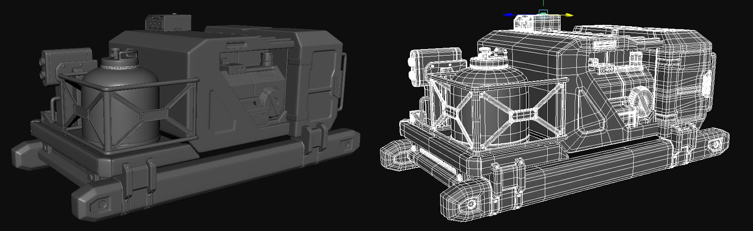

Slide 3
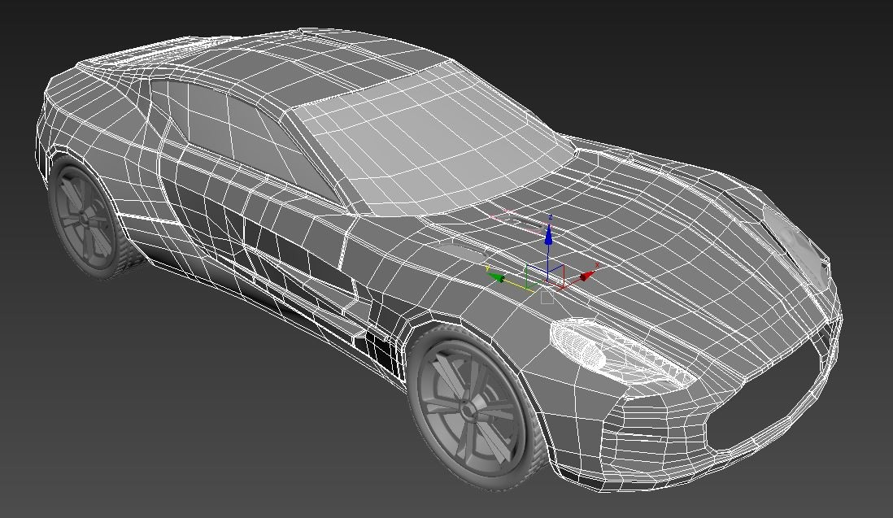

Slide 4
3D Object Representations
Graphical scenes contain different kinds of objects like trees, flowers, rocks, waters, cubes, pyramid.....etc.
To produce realistic display of scenes, we need to use representations that accurately model object characteristics.
Objects like polyhedrons and ellipsoids can be represented by polygon and quadric surfaces.
Spline surface are useful for designing aircraft wings, gears and other engineering objects.
No single method can be used to describe objects that will include all features of those different materials.
Octree encodings are used to represent internal features of objects such as medical CT(Computed Tomography) images.

Slide 5
3D Object Representations
Representation schemes for solid objects are often divided into two broad categories:
1. Boundary representations: describes a 3D object as a set of polygonal surfaces, separate the object interior from external environment.
2. Space-partitioning representation: used to describe interior properties, by partitioning the spatial region, containing an object into a set of small, non-overlapping, contiguous solids. e.g. 3D object as Octree representation.
Examples of Boundary representations >>

Slide 6
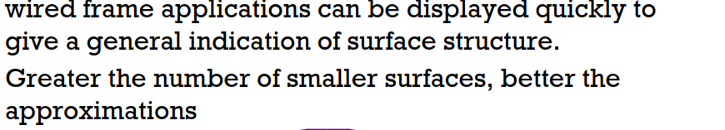
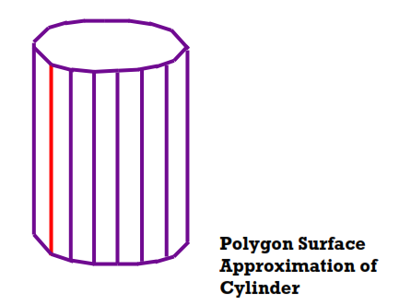
3D Object Representations

Slide 7
Polygon Surfaces
A polygon surface is most common representation for 3D graphics object.
In this representation, a 3D object is represented by a set of surfaces that enclose the object interior.
The polygon surfaces are common in design and solid-modeling applications, Since wire frame display can be done quickly to give general indication of surface structure.
Then realistic scenes are produced by interpolating shading patterns across polygon surface to illuminate

Slide 8
Polygon Table
A polygon table stores the set of vertex co-ordinates description , geometric data & parameter that are associated with attribute parameters.
Attribute parameter specify the surface characteristics such as reflectivity , degree of transparency , color....etc.
A convenient organization for storing geometric data is to create 3 lists:
A vertex table
An edge table
A polygon surface table.

Slide 9
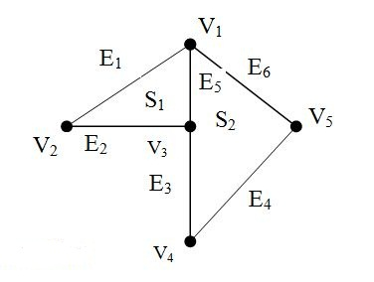
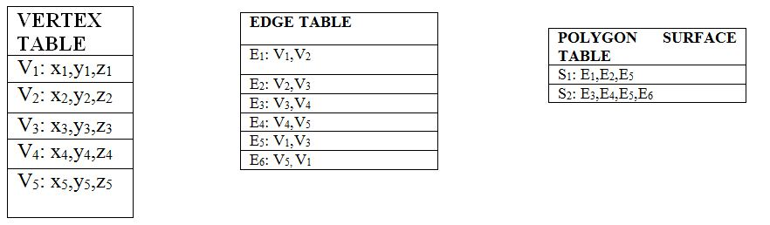
Question: Construct the polygon table for object with 6 vertices , 8 edge and 3 surface.

Slide 10
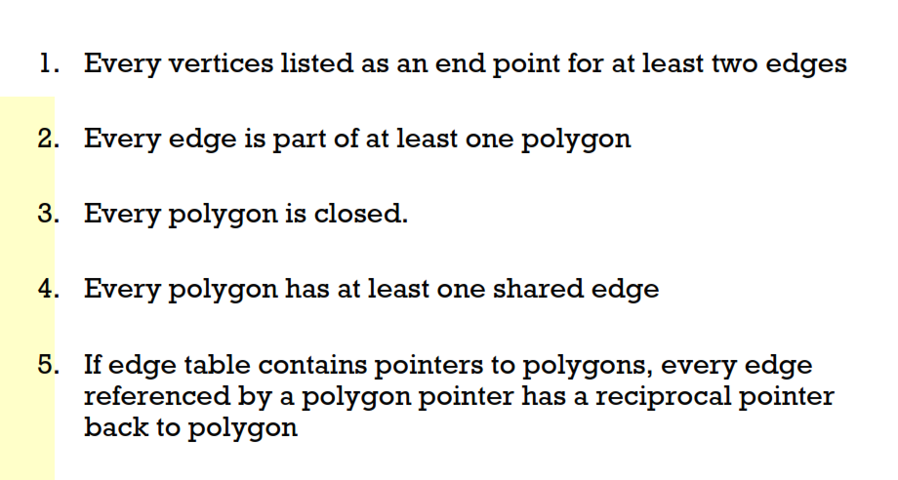
Guideline to generate error free table

Slide 11
Polygon Meshes
A polygon mesh is collection of edges, vertices and polygons connected such that each edge is shared by at most two polygons.
An edge connects two vertices and a polygon is a closed sequence of edges.
An edge can be shared by two polygons and a vertex is shared by at least two edges.

Slide 12
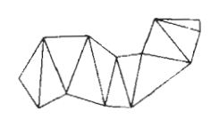
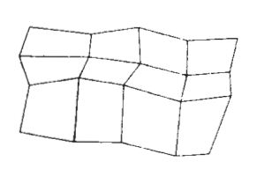
Fig: A triangle strip formed with 11 triangles connecting 13 vertices.
A quadrilateral mesh planes containing 12 quadrilaterals constructed from a 5 by 4 input vertex array.

Slide 13
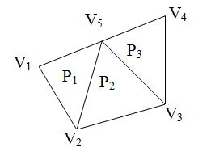
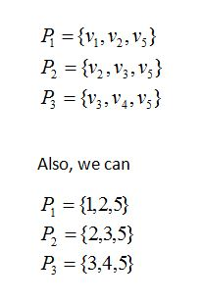
Representing polygon meshes
Representing polygon mesh with each polygon as vertex list.

Slide 14
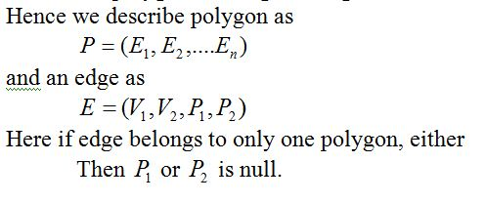
Defining polygons by pointers to an edge list
In this method, we have vertex list V, represent the polygon as a list of pointers not to the vertex list but to an edge list.
Each edge in edge list points to the two vertices in the vertex list, also to one or two polygon, the edge belongs.

Slide 15
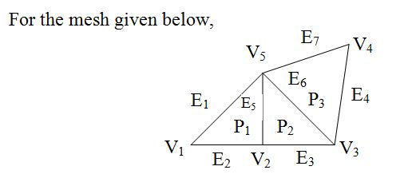
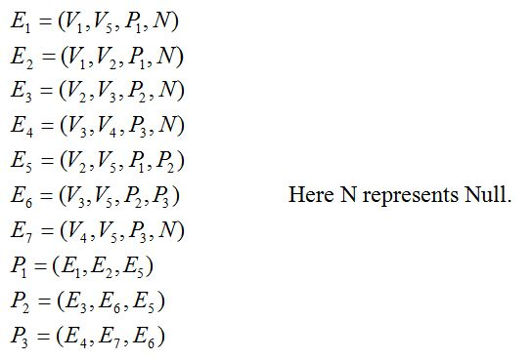

Slide 16
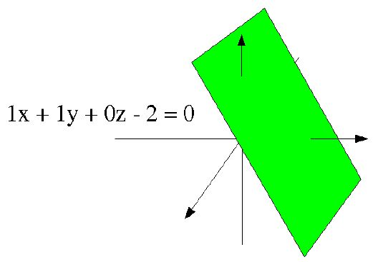
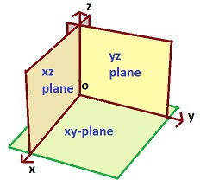
Plane Equation

Slide 17
Plane Equation Method
Plane equation method is another method for representation of the polygon surface for 3D object.
The information about the spatial orientation of object is described by its individual surface, which is obtained by the vertex co-ordinates and the equation of each surface.
The equation for a plane surface can be expressed in the form:
Ax + By + Cz + D = 0

Slide 18
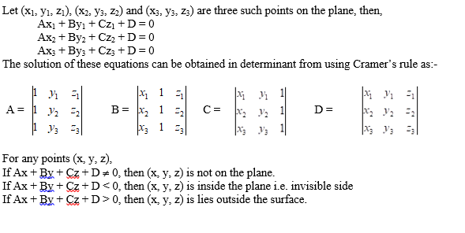
Plane Equation Method

Slide 19
Plane Equation Method
To produce a display of three dimensional object we must process the input data representation for the object through several steps.
These processing steps include:
Transformation of modeling/world coordinate description to view coordinate ,then to device coordinate.
Identification of visible surface and,
The application of surface rendering procedures

Slide 20
Quadric Surface
Quadric Surface is one of the frequently used 3D objects surface representation.
The quadric surface can be represented by a second degree polynomial.
This includes:

Slide 21
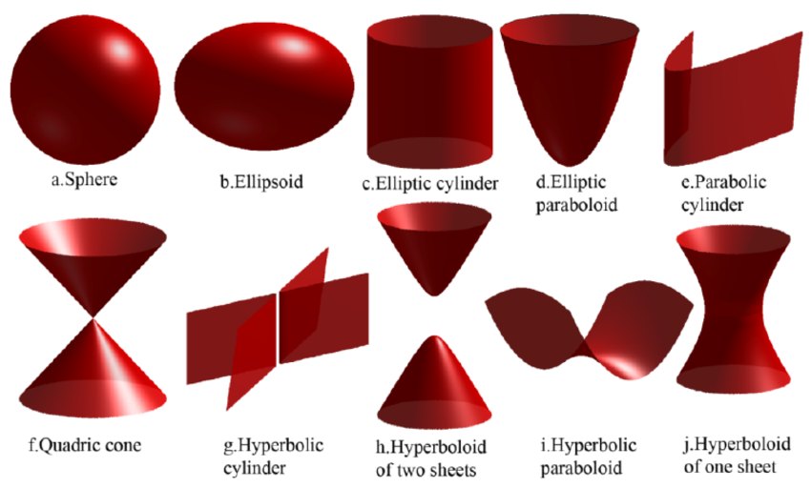
Quadric Surface

Slide 22
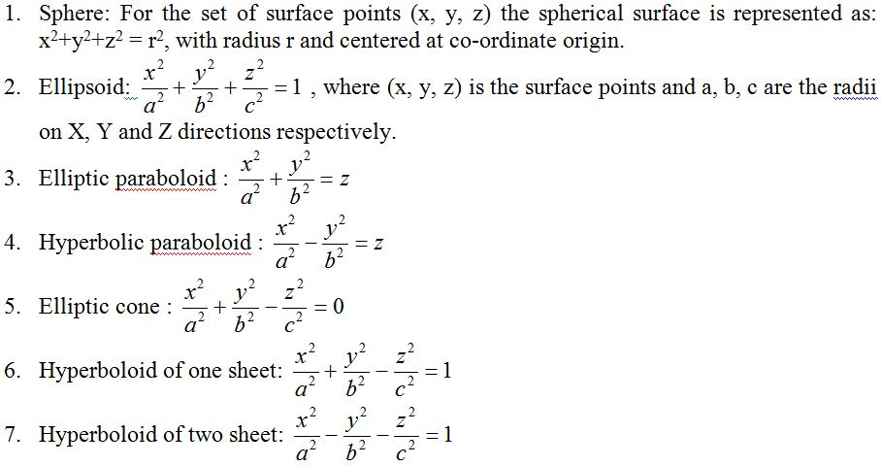
Quadric Surface

Slide 23
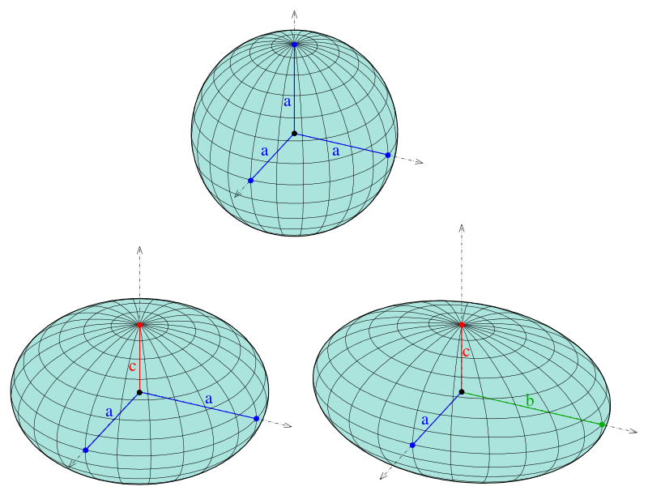
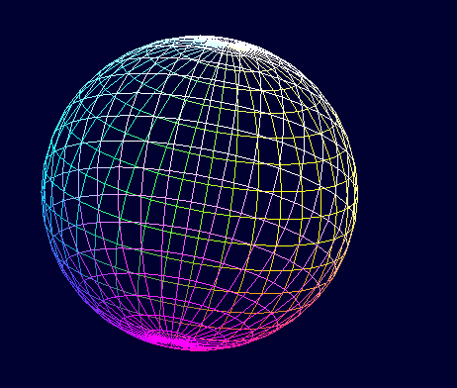
Wireframe Representation

Slide 24
Wireframe Representation
In this method, 3D object is represented as a list of straight lines, each of which is represented by its two end points (x₁, y₁, z₁) and (x₂, y₂, z₂).
This method only shows the skeletal structure of the objects.
It is simple and can see through the object and fast method.
But independent line data structure is very inefficient i.e. don’t know what is connected to what.
In this method the scenes represented are not realistic.

Slide 25
Blobby Objects
Some objects don’t maintain a fixed shape but change their surface characteristics in certain motions or when proximity to another objects
E.g. molecular structures, water droplets, other liquid effects, melting objects, muscle shaped in human body etc.
These objects can be described as exhibiting “blobbiness” and are referred as blobby objects.

Slide 26
Fig: Blobby muscle shapes in a human arm
Fig: Molecular bonding (stretching and contracting into spheres)

Slide 27



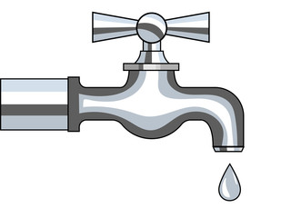

Slide 28
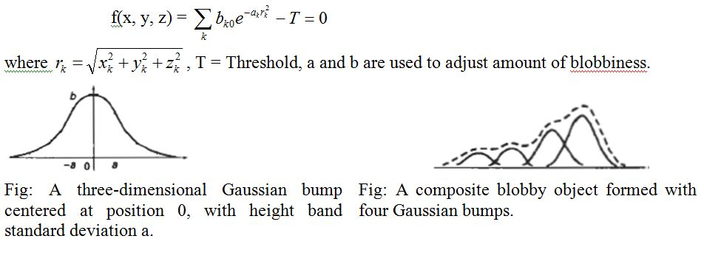
Several models have been developed for representing blobby objects as distribution functions over a region of space. One way is to use Gaussian density function or bumps. A surface function is defined as:

Slide 29
Curve modeling

Slide 30
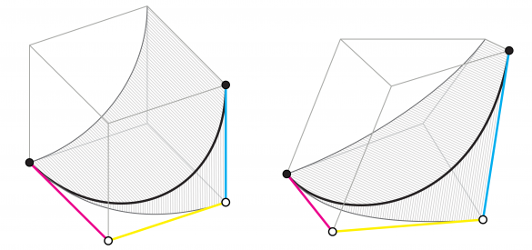
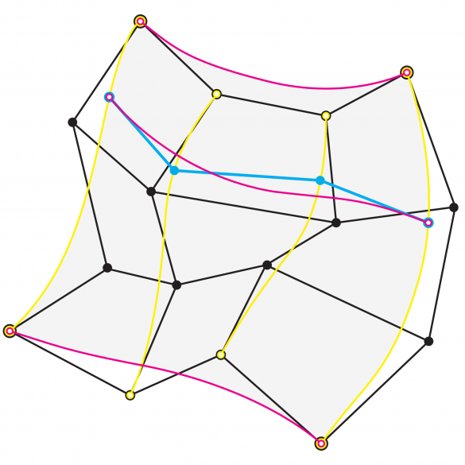

Slide 31
Spline
A spline is a flexible strip used to produce smooth curve through a designated set of points.
A curve drawn with these set of points is spline curve.
E.g. design of automobile bodies, aircraft and spacecraft surface etc.

Slide 32
Control points Interpolation and Approximation
Given the set of control points, the curve is said to interpolate the control point if it passes through each points.
If the curve is fitted from the given control points such that it follows the path of control point without necessarily passing through the set of point, then it is said to approximate the set of control point.

Slide 33
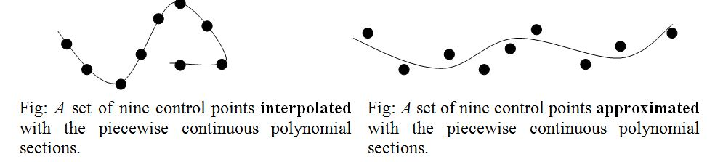

Slide 34
Spline Specifications
Boundary conditions
Characterizing matrix
Blending Functions
Boundary conditions: We can state the set of boundary conditions that are imposed on the spline.
For illustration, suppose we have parametric cubic polynomial representation for the x-coordinate along the path of a spline section:
x(u) = a_{x}u³ + b_{x}u² + c_{x}u + d_{x} 0≤u≤1

Slide 35
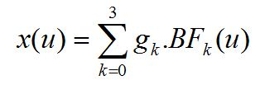
Characterizing matrix: We can state the matrix that characterizes the spline.
From the boundary condition, we can obtain the characterizing matrix for spline. Then the parametric equation can be written as:
Blending Functions:
From matrix representation in B, we can obtain polynomial representation for coordinate x in terms of the geometric constraint parameters:
where g_{k} are the constraint parameters, such as the control-point coordinates and slope of the curve at the control points, and BF_{k}(u) are the polynomial blending functions.

Slide 36
Cubic Spline
Suppose, we have n+1 control points specified with co-ordinates.
p_{u} = (x_{u}, y_{u}, z_{u}), u= 0,1,2,3…………………..n
Fig: A piecewise continuous cubic-spline interpolation of n + 1 control points

Slide 37
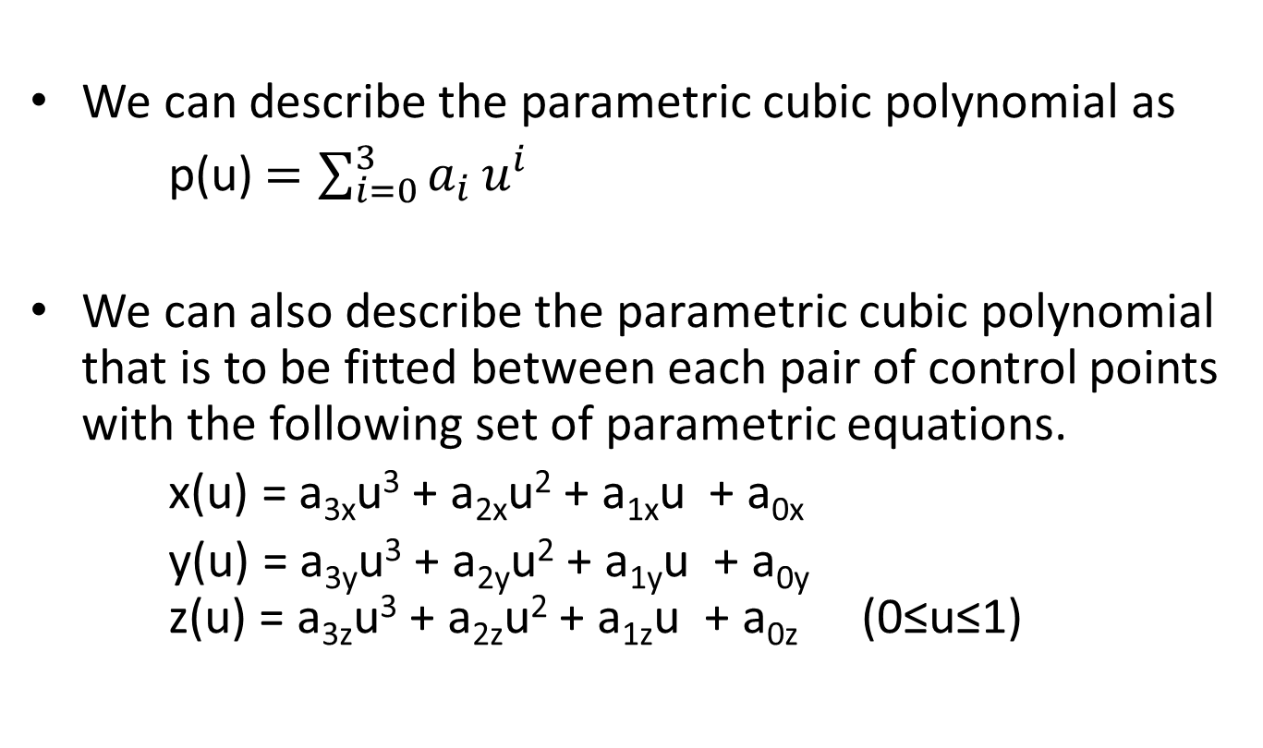
Cubic Spline
We can describe the parametric cubic polynomial as
p(u)$=\sum_{i=0}^{3}{a_{i}}u^{i}$
We can also describe the parametric cubic polynomial that is to be fitted between each pair of control points with the following set of parametric equations.
x(u) = a_{3x}u³ + a_{2x}u² + a_{1x}u + a_{0x}
y(u) = a_{3y}u³ + a_{2y}u² + a_{1y}u + a_{0y} z(u) = a_{3z}u³ + a_{2z}u² + a_{1z}u + a_{0z} (0≤u≤1)

Slide 38
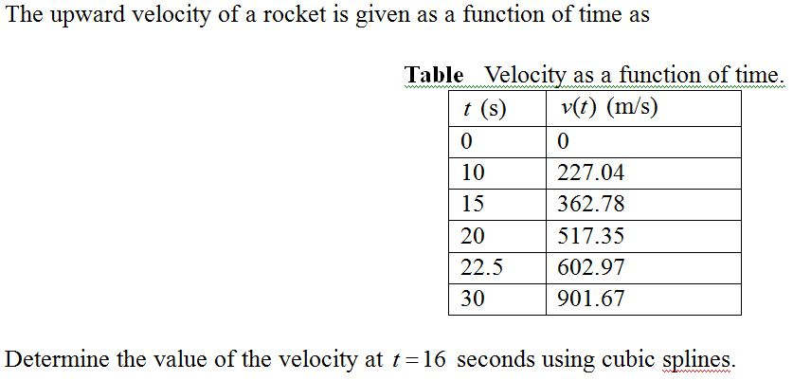
Question

Slide 39
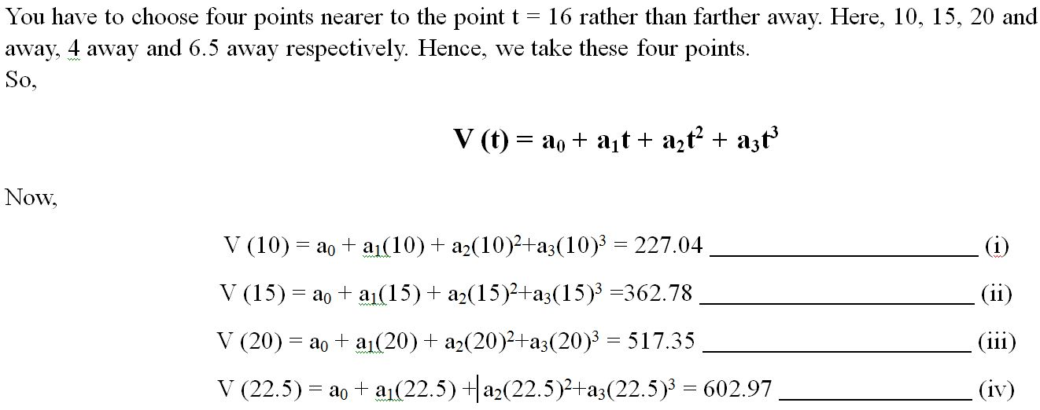
Solution
22.5. are nearer. Hence we take these points.

Slide 40
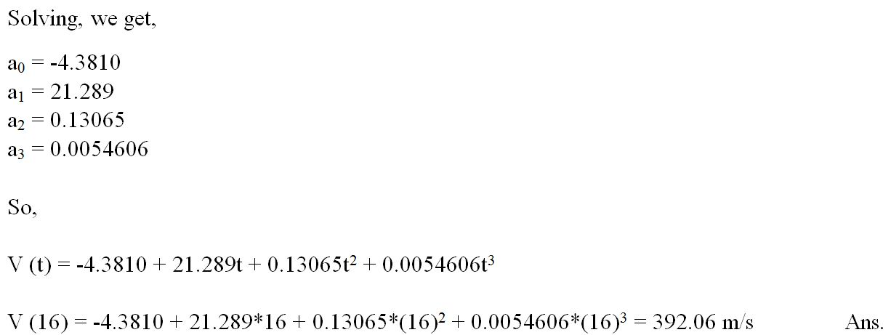

Slide 41
Bezier Curve

Slide 42
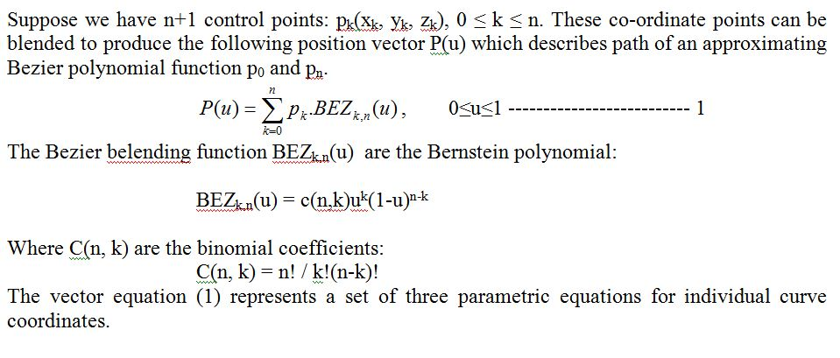
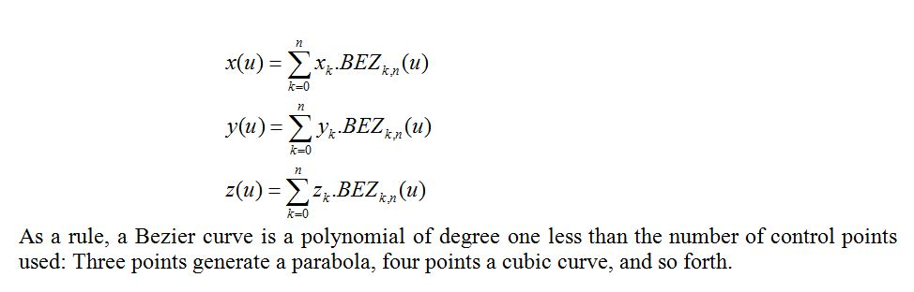

Slide 43
Properties of Bezier Curves
It always passes through initial and final control points. i.e P(0) = p₀ and P(1) = p_{n}.
Values of the parametric first derivatives of a Bezier curve at the end points can be calculated from control points as:
P'(0) = -np₀ + np₁
P'(1) = -np_{n-1} + np_{n}
The slope at the beginning of the curve is along the line joining the first two points and slope at the end of curve is along the line joining last two points.
Parametric second derivative of a Bezier curve at end points are calculated as:
P"(0) = n(n-1)[(p₂-p₁)-(p₁-p₀)]
P"(1) = n(n-1)[(p_{n-2}-p_{n-1}) – (p_{n-1}-p_{n})]
5. It lies within the convex hull of the control points. This follows from the properties of Bezier blending functions: they are all positive and their sum is always 1.

Slide 44
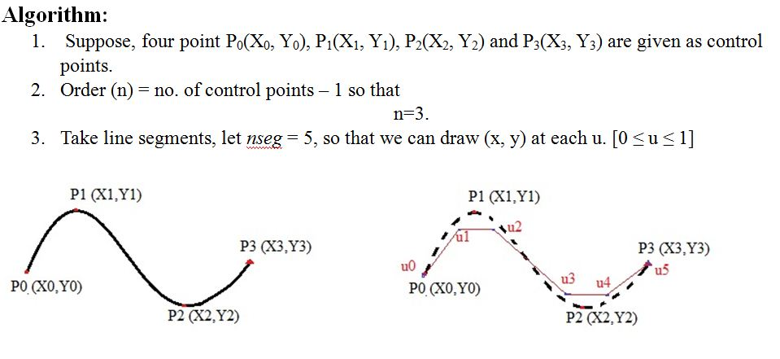
How to construct a Bezier curve?

Slide 45
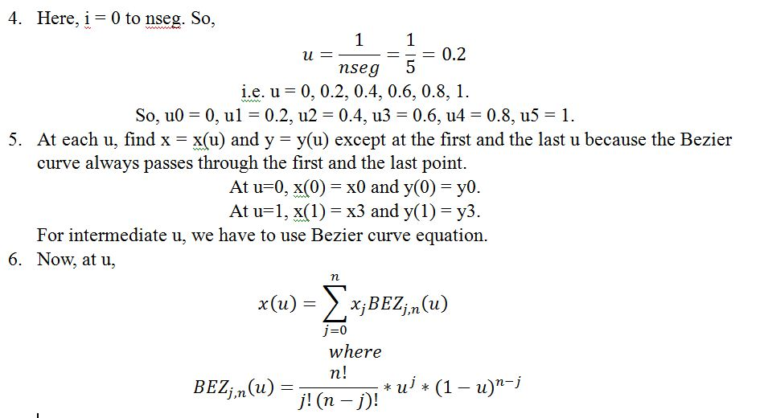

Slide 46
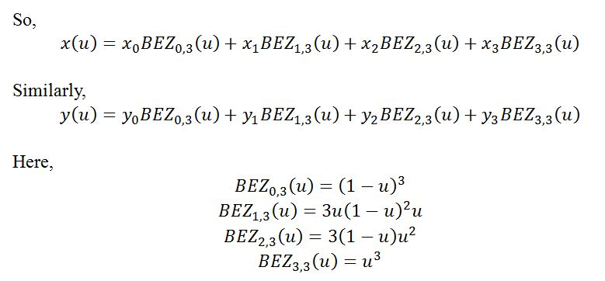

Slide 47
Question
Construct the Bezier curve of order 3 with 4 polygon vertices A(1, 1), B(2, 3), C(4, 3) and D(6, 4).

Slide 48
Solid modeling

Slide 49
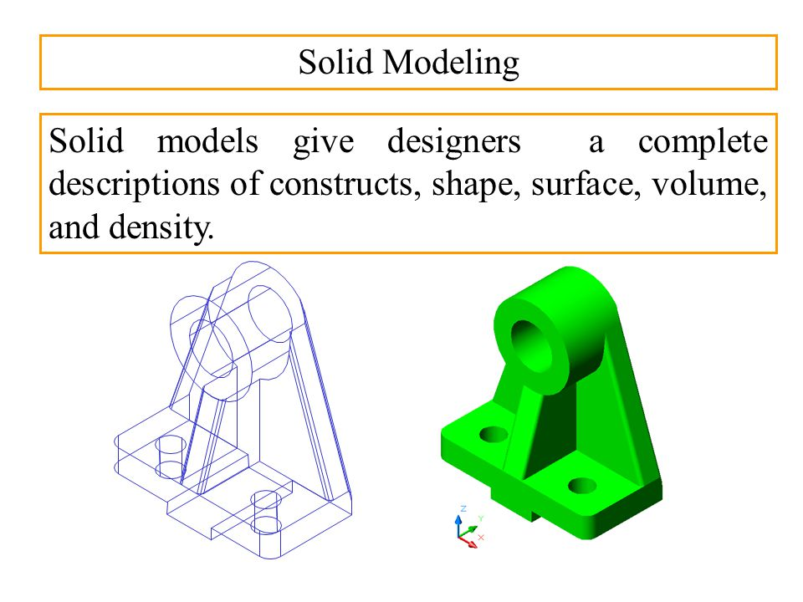
Solid modeling
Solid modeling gives designers a complete descriptions of constructs , shape surface , volume and density.

Slide 50
Solid modeling
Solid modeling is a consistent set of principles of mathematics and computer modeling of three-dimensional solids.
In general it is the creation, exchange, visualization, animation, interrogation, and annotation of digital models of physical objects.
It allows for the automation of several difficult engineering calculations that are carried out as a part of the design process.
Simulation, planning, and verification of processes in machining and assembly are one of the main catalysts for the development of solid modeling.
The principles of geometric and solid modeling form the foundation of 3D-Computer-aided design.

Slide 51
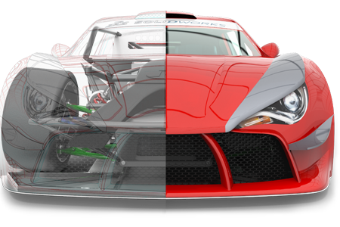

Slide 52
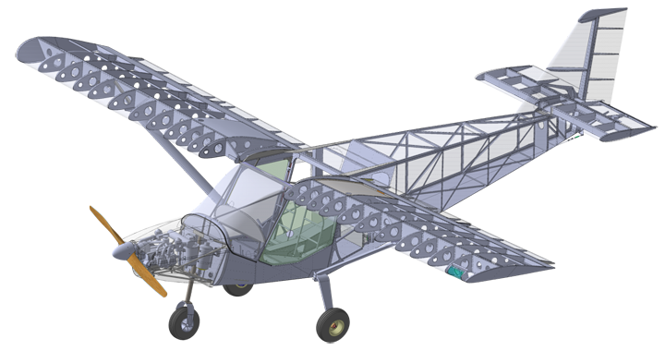

Slide 53
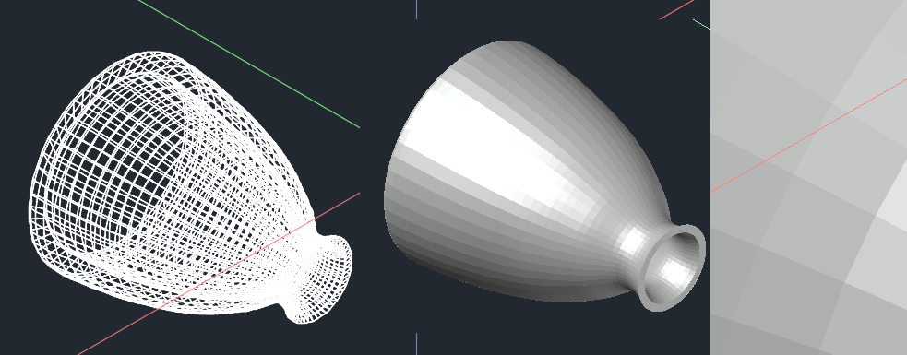
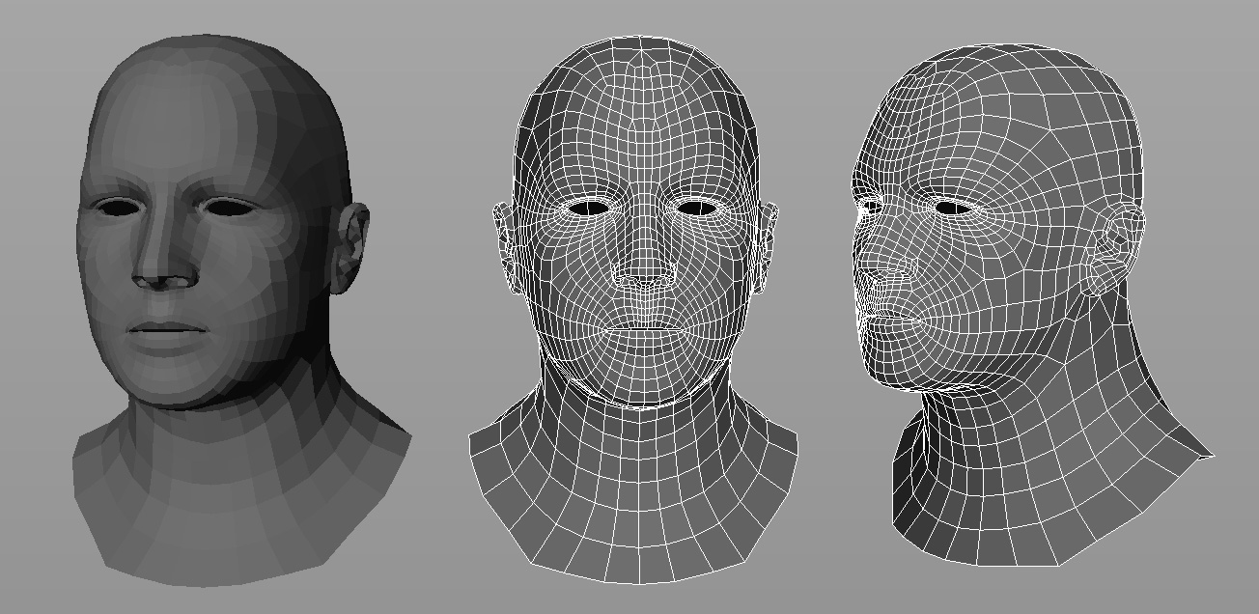

Slide 54
Sweep representation
Sweep is method to generate solid with the help of 2D structures.
The displacement of an object according to a trajectory define another object.
Sweep representations are used to construct 3D object from 2D shape that have some kind of symmetry.
Also, we can define a path for a sweep that allows you to create more interesting shapes.

Slide 55
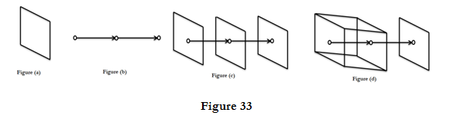
Sweep representation
Translational sweep:
i. Define a shape as a polygon vertex table as shown in figure 33 (a).
ii. Define a sweep path as a sequence of translation vectors figure 33 (b).
iii. Translate the shape; continue building a vertex table figure 33 (c).
iv. Define a surface table figure 33 (d).

Slide 56
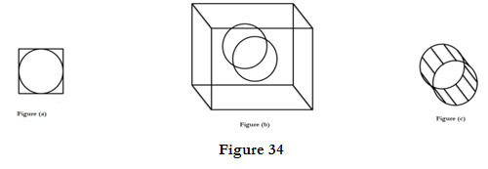
Sweep representation
Rotational sweep:
i. Define a shape as a polygon vertex table as shown in figure 34 (a).
ii. Define a sweep path as a sequence of rotations.
iii. Rotate the shape; continue building a vertex table as shown in figure 34 (b).
iv. Define a surface table as shown in figure 34 (c).

Slide 57
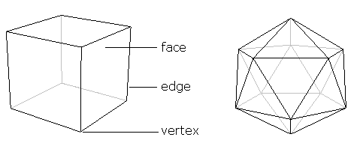
Boundary representation (B- rep):
Boundary representation—often abbreviated as B-rep or BREP—is a method for representing shapes using the limits.
It is also known as extended form of wireframe model
It describes the solids in terms of its surface boundaries: vertices, edges and faces.
There are 2 types of information in a B-rep i.e. topological and geometrical.

Slide 58
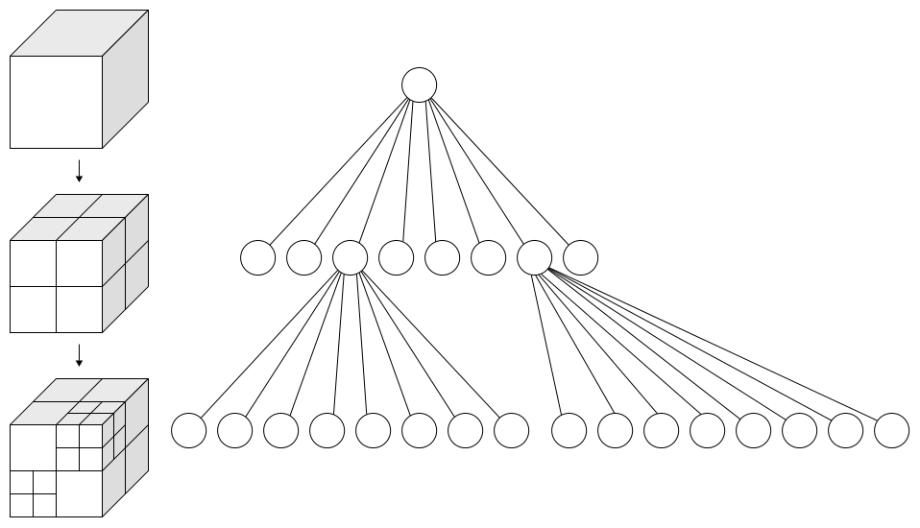
Octree
An octree is a tree data structure in which each internal node has exactly eight children. Octrees are most often used to partition a three-dimensional space by subdividing it into eight octants.

Slide 59
Octree Representation
This is the space-partitioning representation method for 3D solid object representation.
Medical imaging and other applications that require displays of object cross section commonly use this method. E.g. CT-scan.
Quadtrees are also generated by successively dividing a two-dimensional region (usually a square) into quadrants.

Slide 60
Fig: Region of a two-dimensional space divided into numbered quadrants
and the associated quad tree node with four data elements
Fig: Region of a three-dimensional space divided into numbered octants
and the associated octree node with eight data elements (voxels)

Slide 61
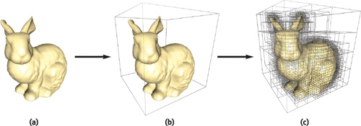
Octree Representation

Slide 62
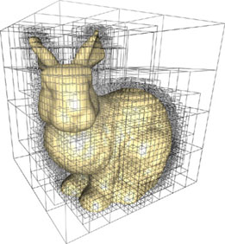
Octree Representation

Slide 63
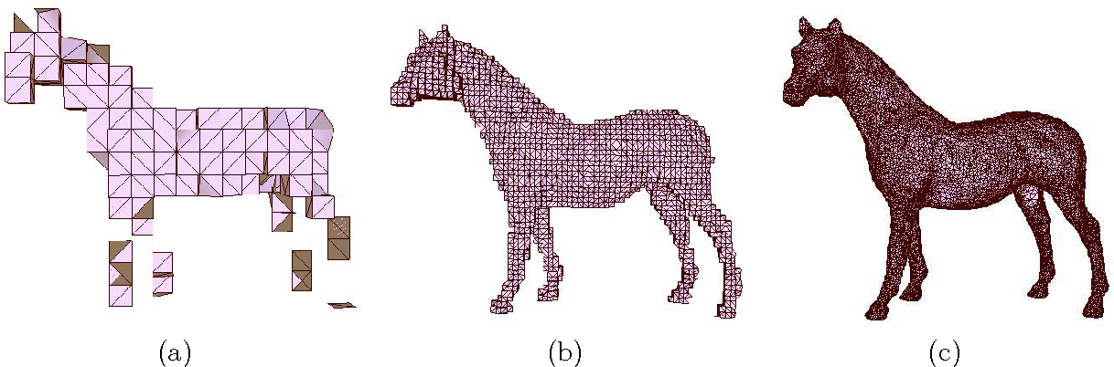
Octree Representation

